Slide 1



Control and Automation IC2122 Robotics Lab with VREP
Instructor:
Industrial Centre
The Hong Kong Polytechnic University

Slide 2

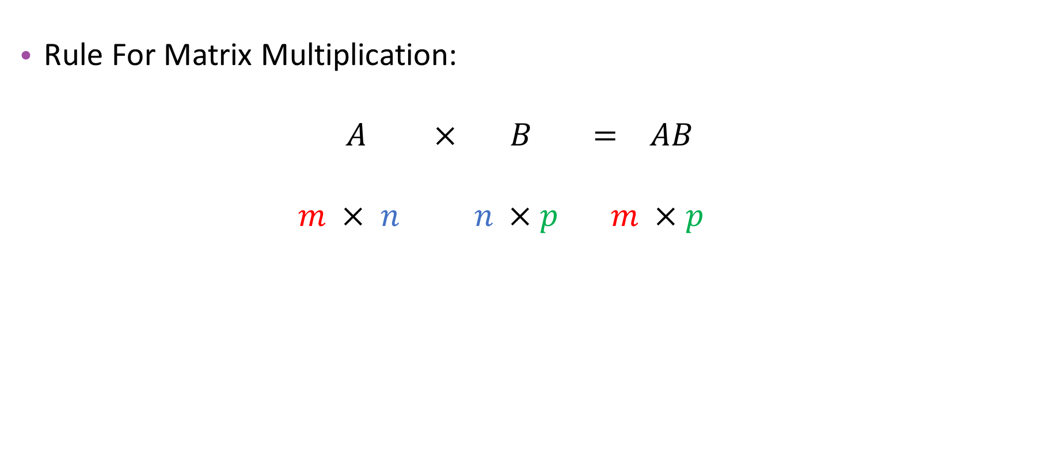
Matrix Multiplication
Rule For Matrix Multiplication:
$$A × B = AB$$
$$m × n n ×p m ×p$$
Equal
Dimensions of AB

Slide 3
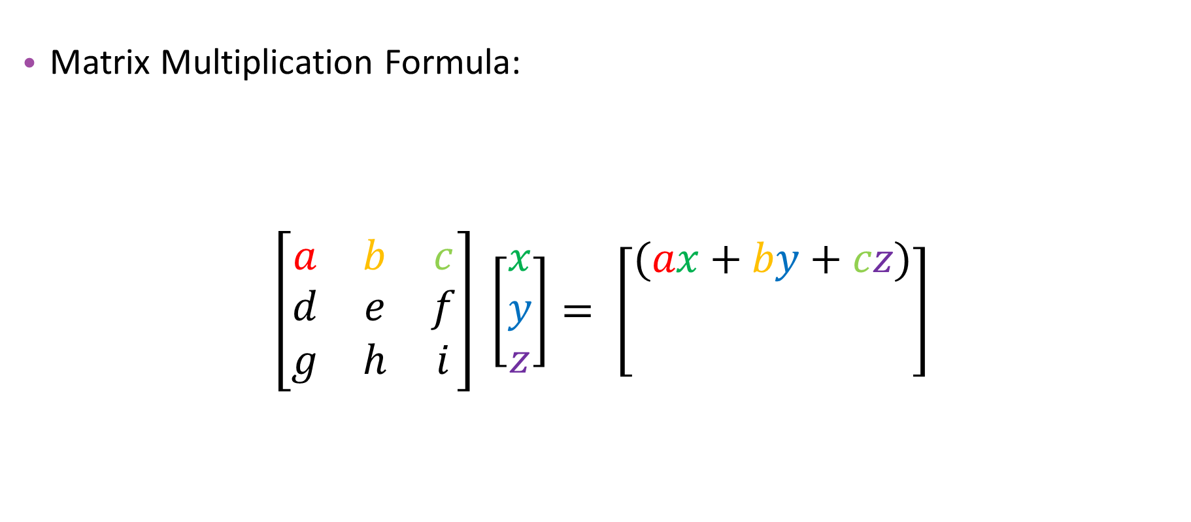
Matrix Multiplication
Matrix Multiplication Formula:
$\left[\begin{matrix}a & b & c \\ d & e & f \\ g & h & i\end{matrix}\right] \left[\begin{matrix}x \\ y \\ z\end{matrix}\right]= \left[\begin{matrix}(ax+by+cz) \\ \\ \end{matrix}\right]$
3 x 3
3 x 1
3 x 1

Slide 4
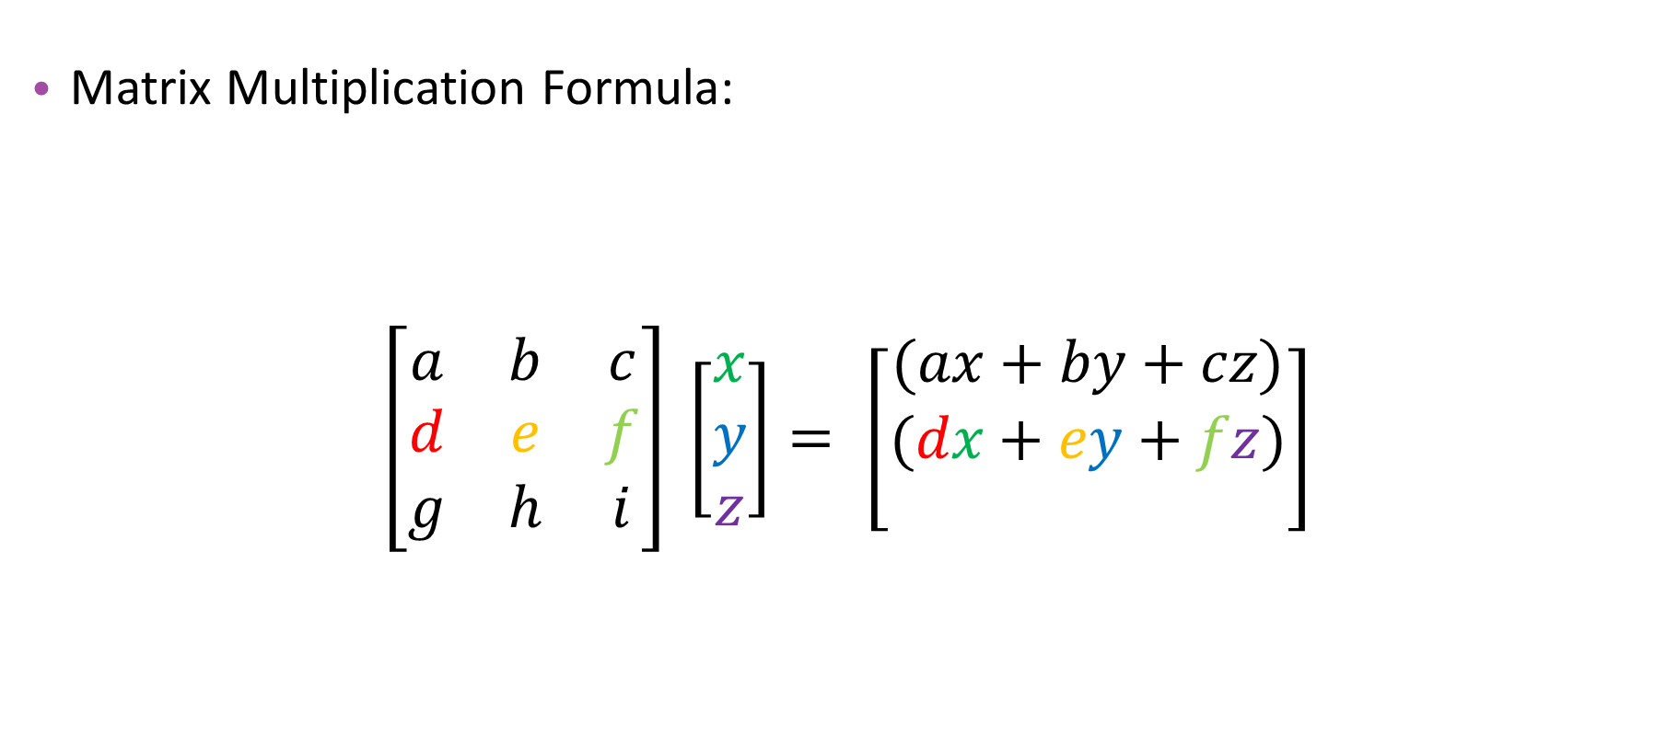
Matrix Multiplication
Matrix Multiplication Formula:
$\left[\begin{matrix}a & b & c \\ d & e & f \\ g & h & i\end{matrix}\right] \left[\begin{matrix}x \\ y \\ z\end{matrix}\right]= \left[\begin{matrix}(ax+by+cz) \\ (dx+ey+fz) \\ \end{matrix}\right]$
3 x 3
3 x 1
3 x 1

Slide 5
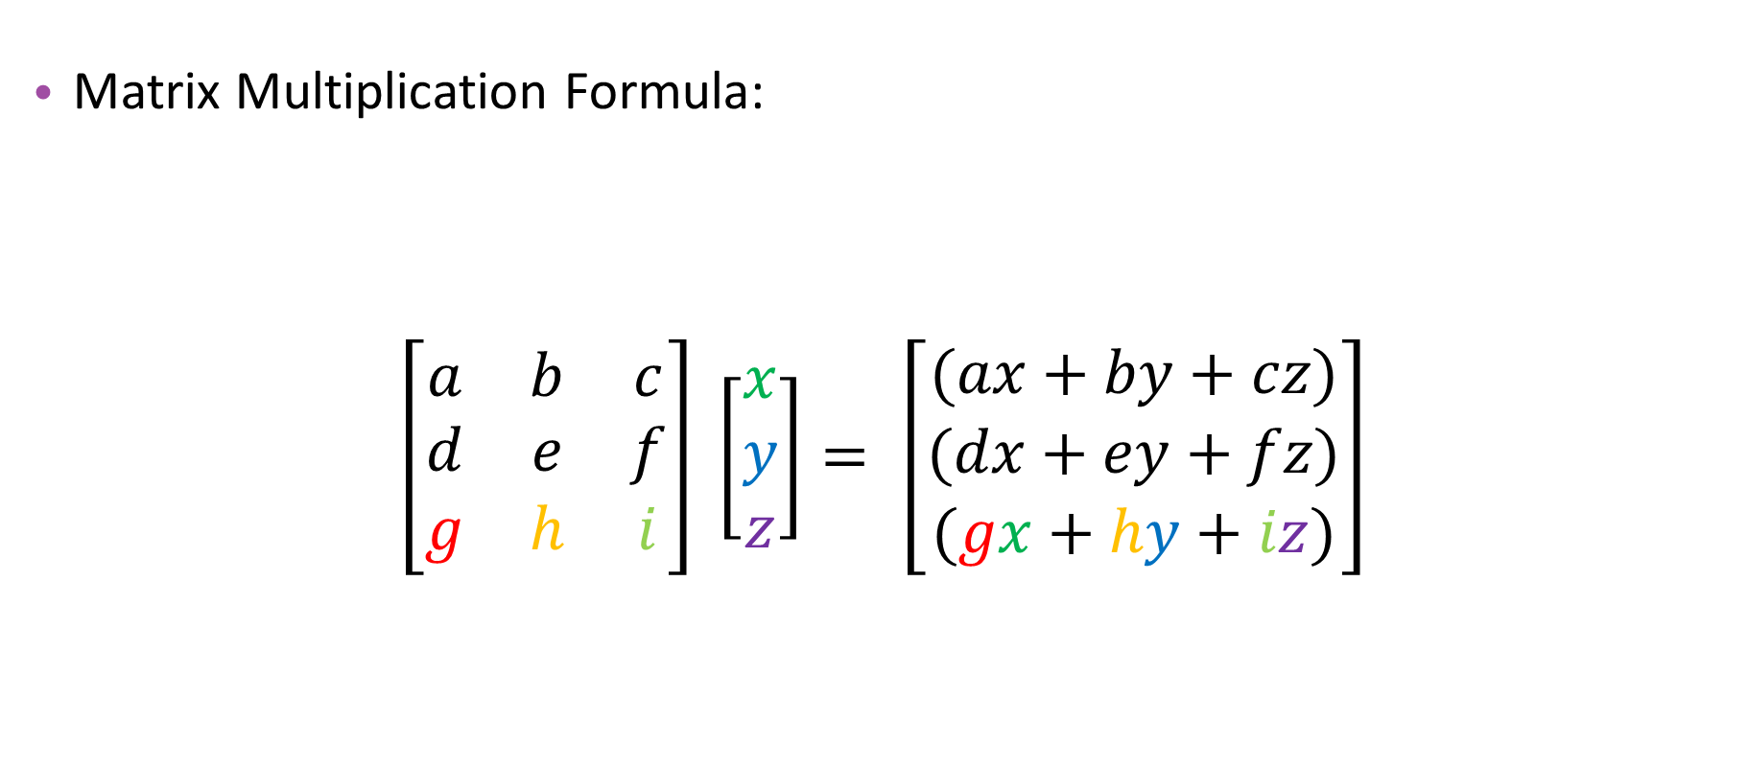
Matrix Multiplication
Matrix Multiplication Formula:
$\left[\begin{matrix}a & b & c \\ d & e & f \\ g & h & i\end{matrix}\right] \left[\begin{matrix}x \\ y \\ z\end{matrix}\right]= \left[\begin{matrix}(ax+by+cz) \\ (dx+ey+fz) \\ (gx+hy+iz)\end{matrix}\right]$
3 x 3
3 x 1
3 x 1

Slide 6
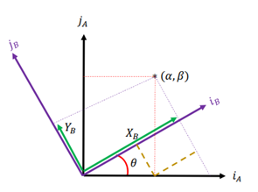
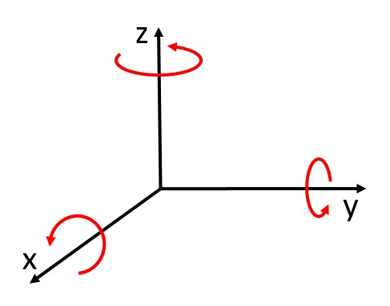
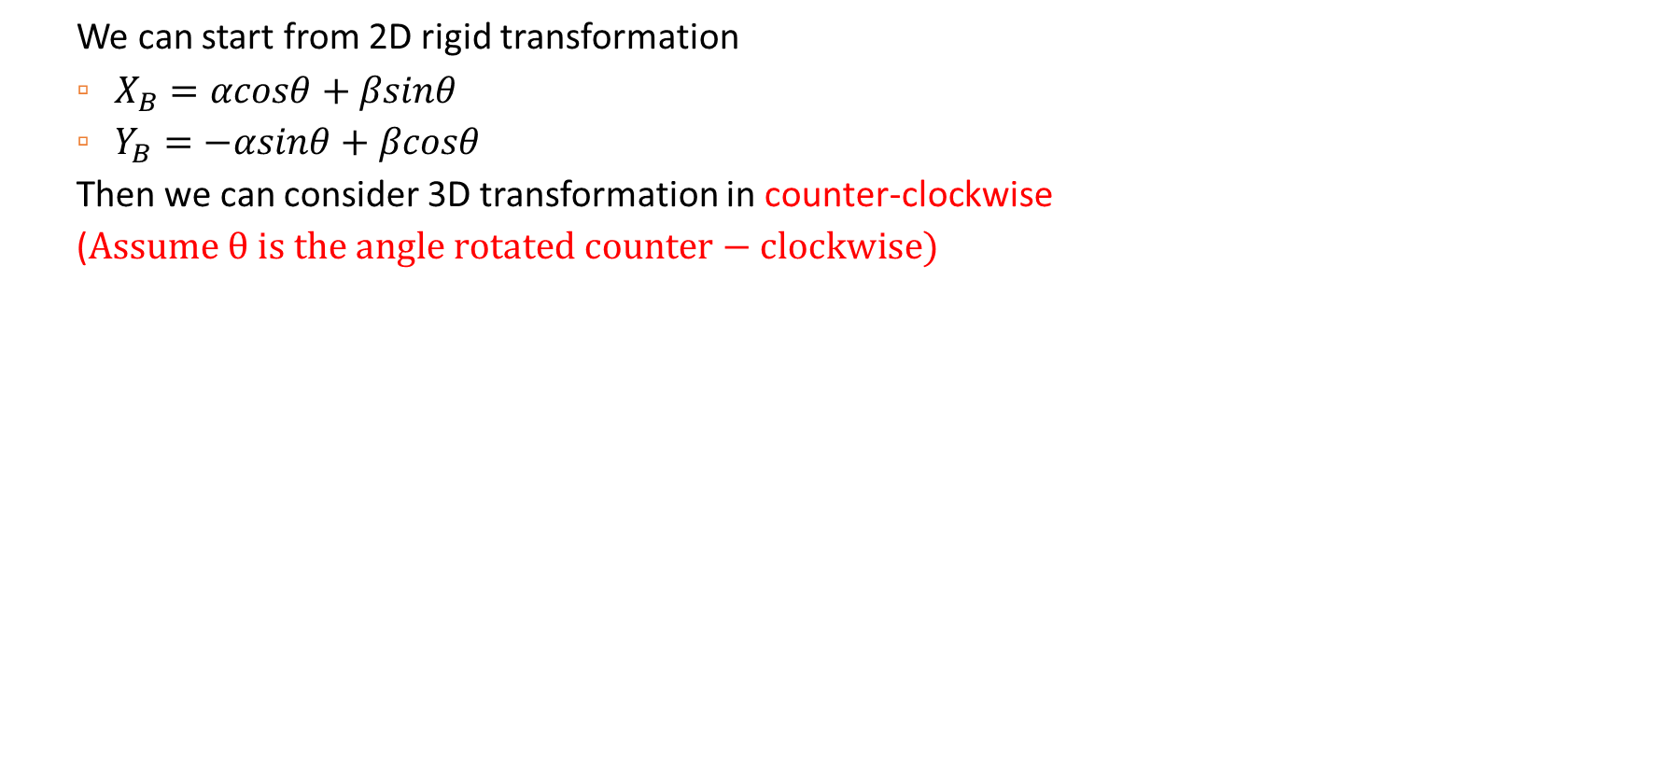
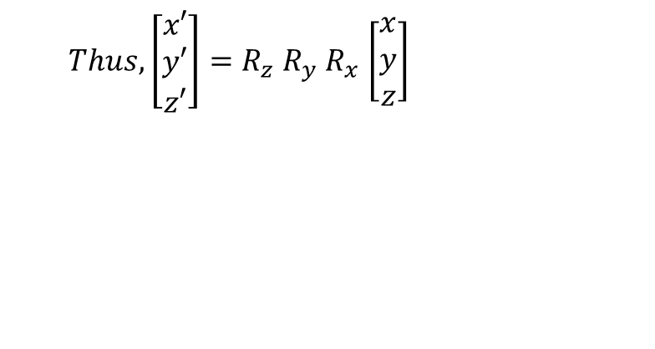
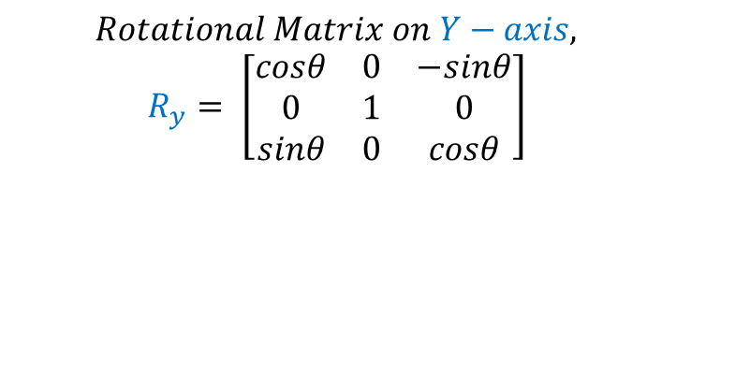
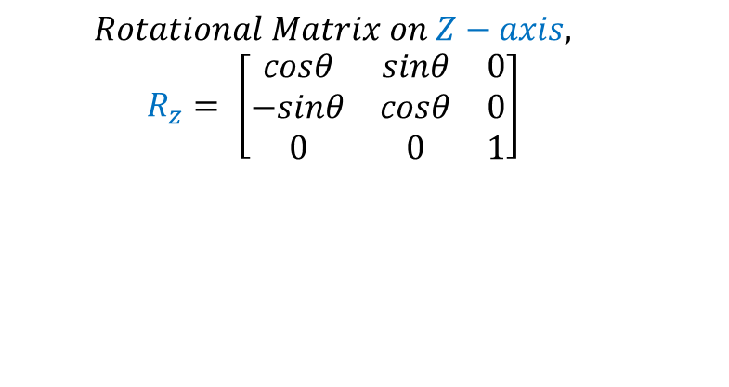

3D Transformation
We can start from 2D rigid transformation
$X_{B}=αcosθ+βsinθ$
$Y_{B}=−αsinθ+βcosθ$
Then we can consider 3D transformation in counter-clockwise
($Assume θ is the angle rotated counter−clockwise)$
$$Rotational Matrix on Z−axis,$$
$$R_{z}= \left[\begin{matrix}cosθ & sinθ & 0 \\ −sinθ & cosθ & 0 \\ 0 & 0 & 1\end{matrix}\right]$$
$$Rotational Matrix on Y−axis,$$
$$R_{y}= \left[\begin{matrix}cosθ & 0 & −sinθ \\ 0 & 1 & 0 \\ sinθ & 0 & cosθ\end{matrix}\right]$$
Rotation Matrix
$$Rotational Matrix on X−axis,$$
$$R_{x}=\left[\begin{matrix}1 & 0 & 0 \\ 0 & cosθ & sinθ \\ 0 & −sinθ & cosθ\end{matrix}\right]$$
$Thus, \left[\begin{matrix}x′ \\ y′ \\ z′\end{matrix}\right]=R_{z}$ $R_{y}$ $R_{x}$ $\left[\begin{aligned}x \\ y \\ z\end{aligned}\right]$
Previous position
Final position

Slide 7
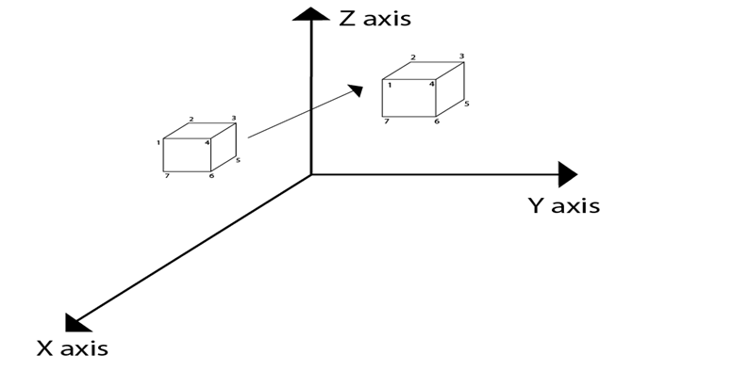
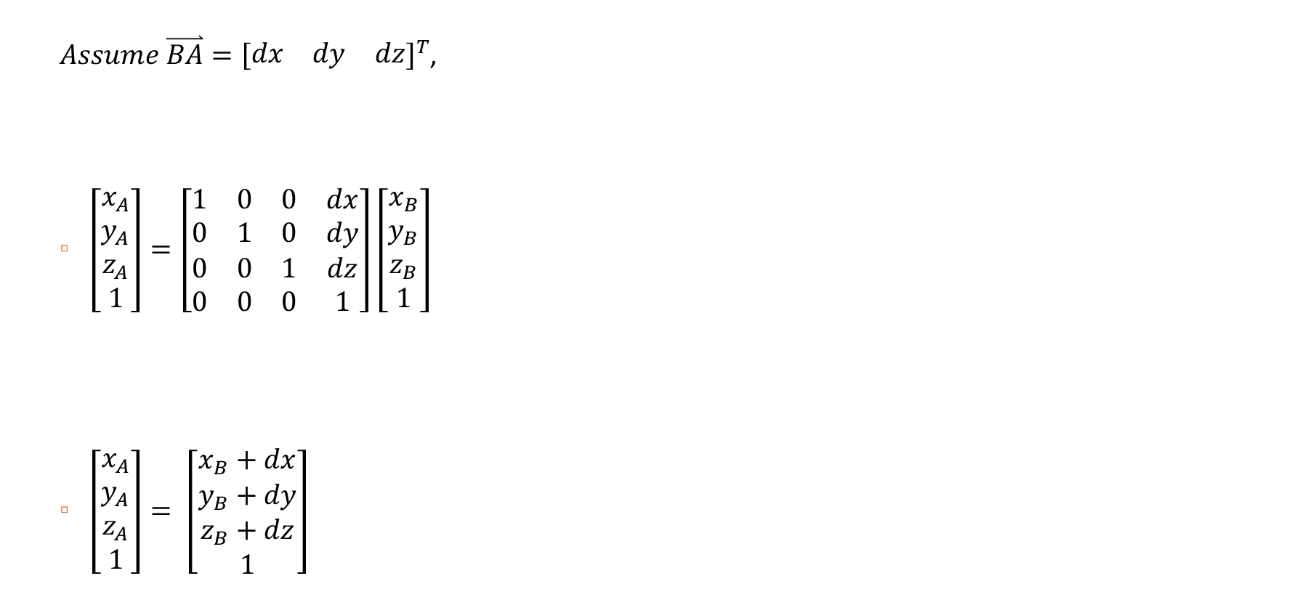
3D Transformation
$Assume \overset{⃑}{BA}={\left[\begin{matrix}dx & dy & dz\end{matrix}\right]}^{T}$,
$\left[\begin{aligned}x_{A} \\ y_{A} \\ z_{A} \\ 1\end{aligned}\right]=\left[\begin{matrix}1 & 0 & 0 & dx \\ 0 & 1 & 0 & dy \\ 0 & 0 & 1 & dz \\ 0 & 0 & 0 & 1\end{matrix}\right]\left[\begin{aligned}x_{B} \\ y_{B} \\ z_{B} \\ 1\end{aligned}\right]$
$\left[\begin{aligned}x_{A} \\ y_{A} \\ z_{A} \\ 1\end{aligned}\right]= \left[\begin{aligned}x_{B}+dx \\ y_{B}+dy \\ z_{B}+dz \\ 1\end{aligned}\right]$
Translation matrix

Slide 8
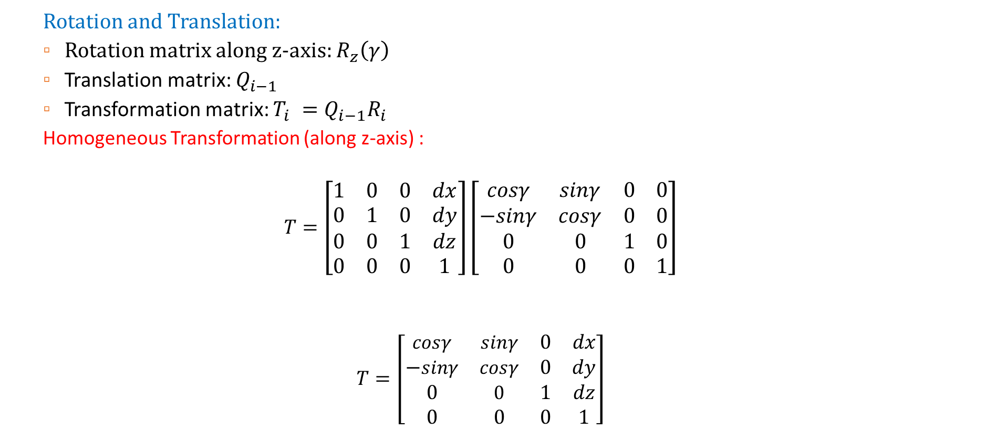
Homogeneous Transformation
Rotation and Translation:
Rotation matrix along z-axis: $R_{z}\left(γ\right)$
Translation matrix: $Q_{i−1}$
Transformation matrix: $T_{i} =Q_{i−1}R_{i}$
Homogeneous Transformation (along z-axis) :
$$T=\left[\begin{matrix}1 & 0 & 0 & dx \\ 0 & 1 & 0 & dy \\ 0 & 0 & 1 & dz \\ 0 & 0 & 0 & 1\end{matrix}\right]\left[\begin{matrix}cosγ & sinγ & 0 & 0 \\ −sinγ & cosγ & 0 & 0 \\ 0 & 0 & 1 & 0 \\ 0 & 0 & 0 & 1\end{matrix}\right]$$
$$T=\left[\begin{matrix}cosγ & sinγ & 0 & dx \\ −sinγ & cosγ & 0 & dy \\ 0 & 0 & 1 & dz \\ 0 & 0 & 0 & 1\end{matrix}\right]$$
yaw
Translation matrix
Rotation Matrix (z-axis)

Slide 9
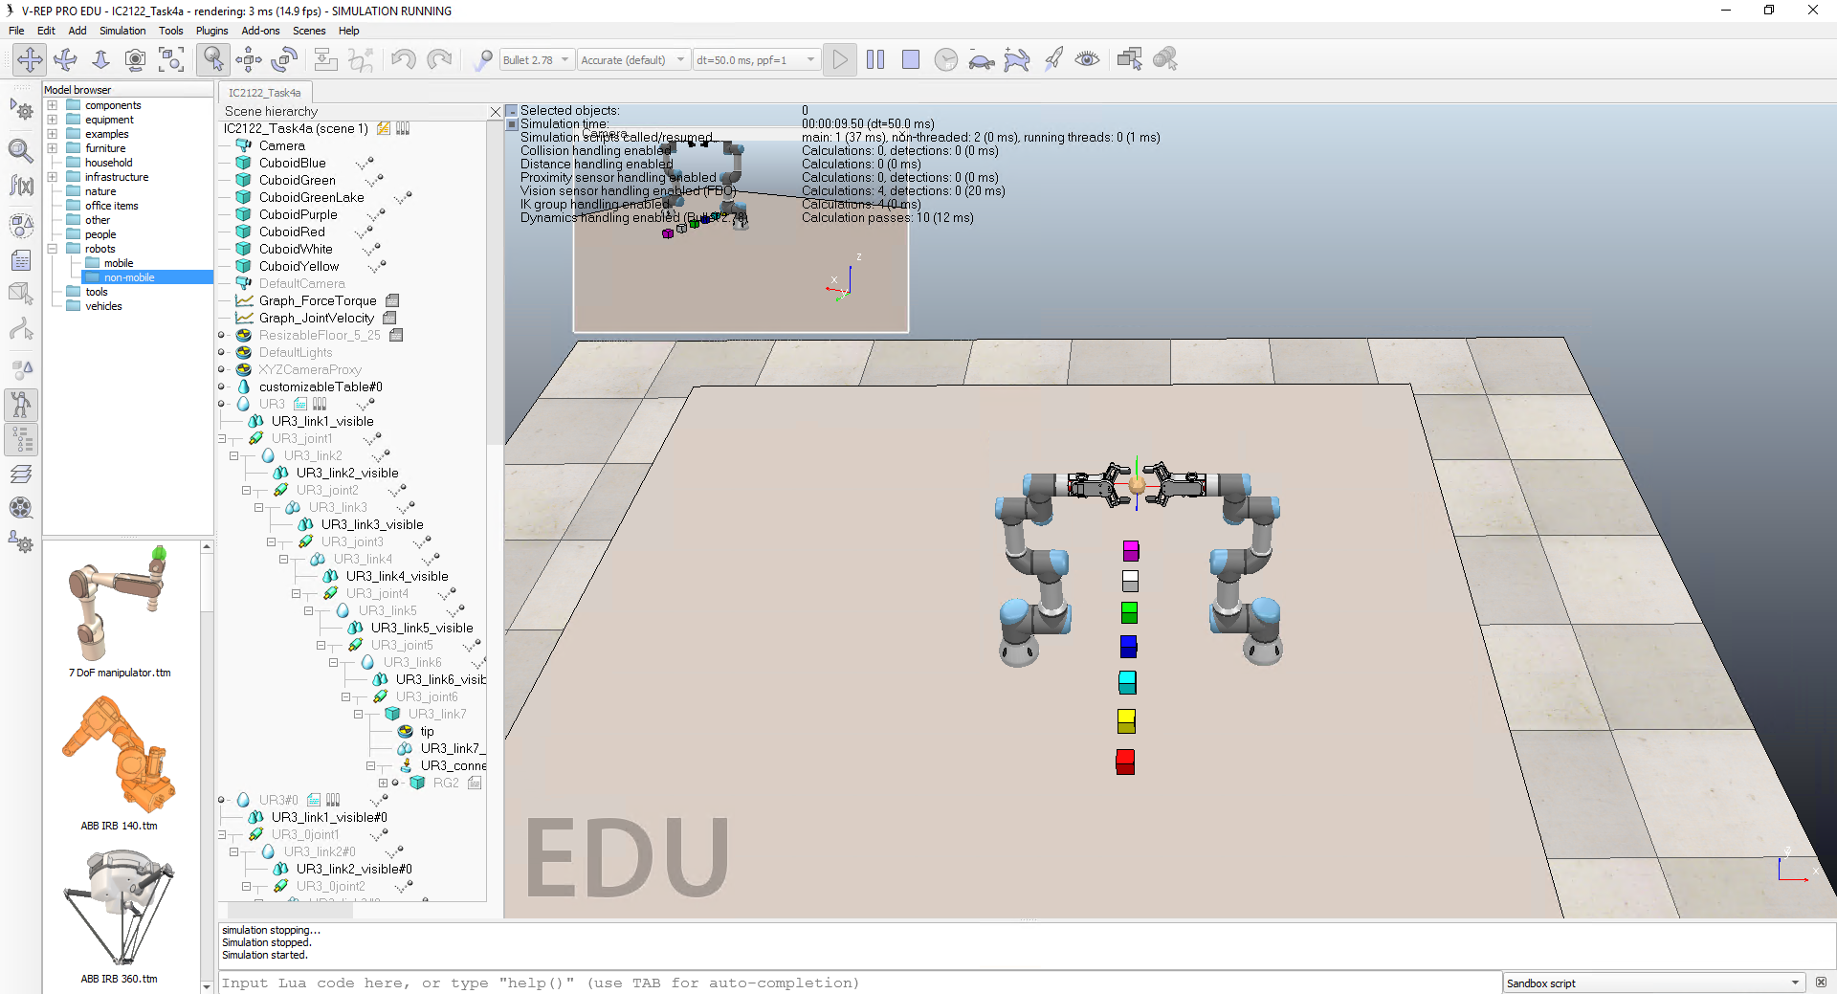
Task 4: Homogeneous Transformation

Slide 10
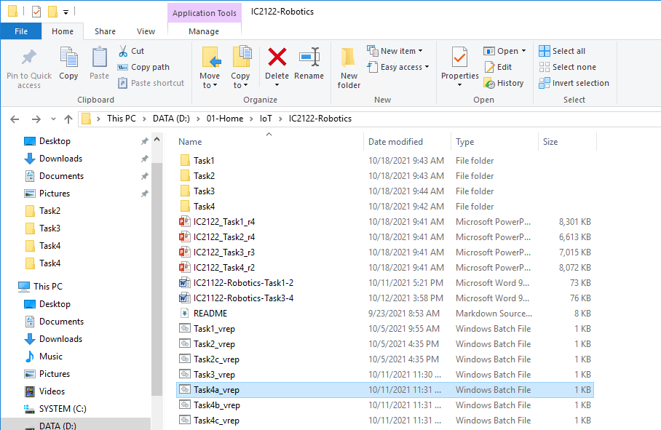
Start-up – V-REP
Start the V-REP (Task4a_vrep.bat)
D:\01-Home\IoT\IC2122-Robotics
Double-Click

Slide 11

Start-up – Anaconda Navigator
Start the Anaconda Navigator on Taskbar or search Windows
Search Anaconda Navigator and click the icon
OR
Click Anaconda Icon

Slide 12
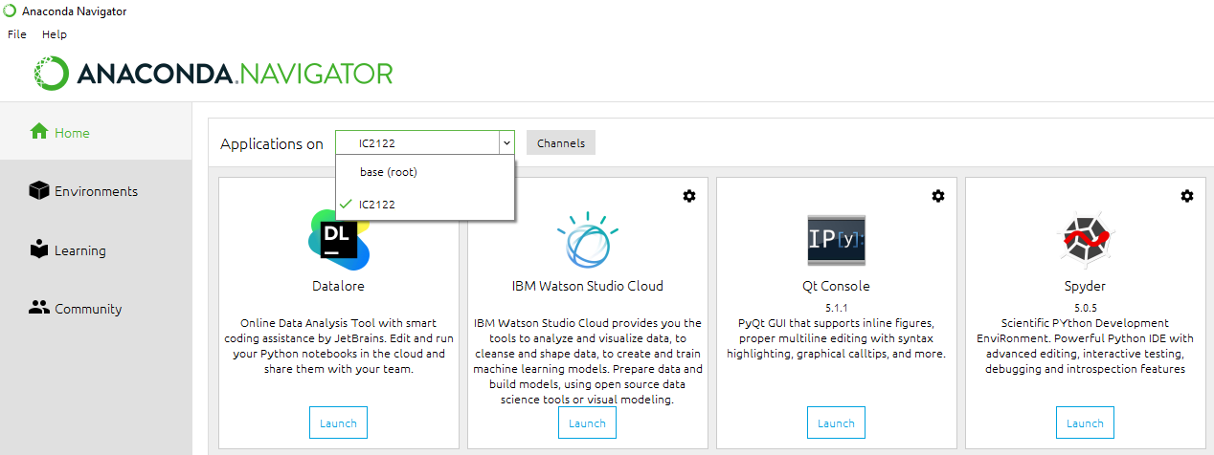
Start-up – Spyder
Launch Spyder
2
1
3
4

Slide 13
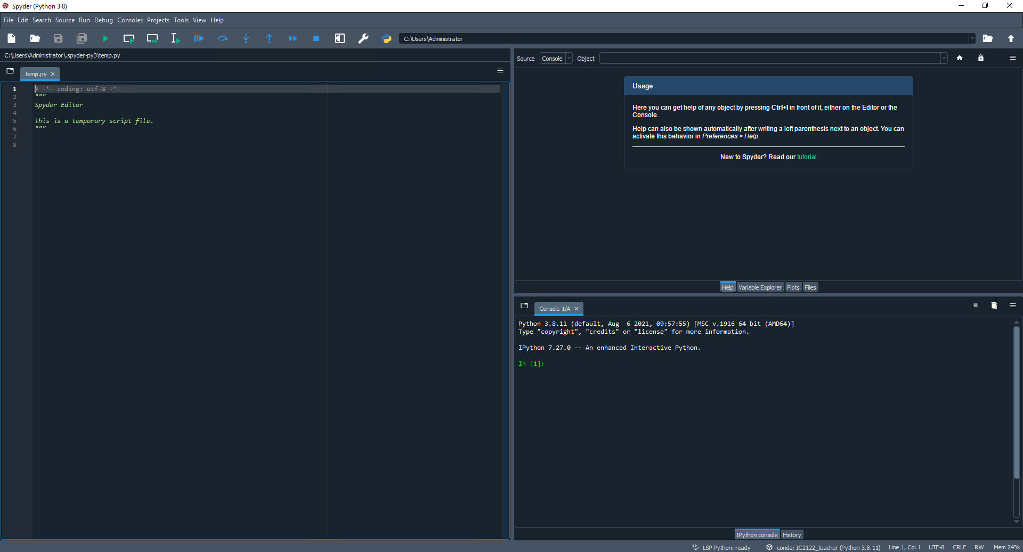
Start-up – Spyder
Toolbar
Help
Editor
IPython Console
Status Bar

Slide 14
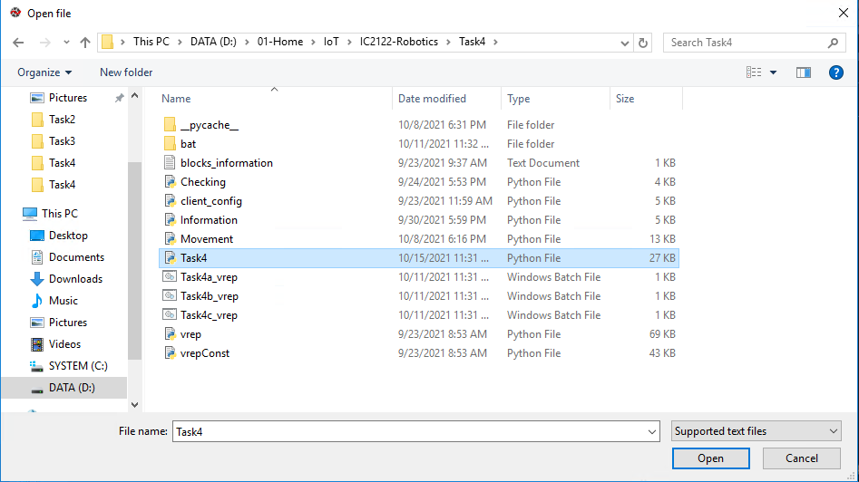
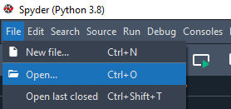

Start-up – Spyder
D:\01-Home\IoT\IC2122-Robotics\Task4
Open Python file at editor
Run the program at Spyder
3
1
2
4
6
5

Slide 15
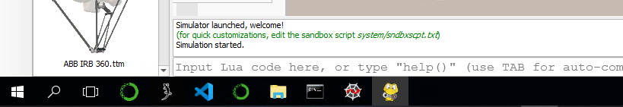
Start-up – Control panel window
Control panel window will be appeared after running the program
After switching to the V-REP, the control panel window will be hidden
Click the Control panel window icon to open it.
Click this icon

Slide 16
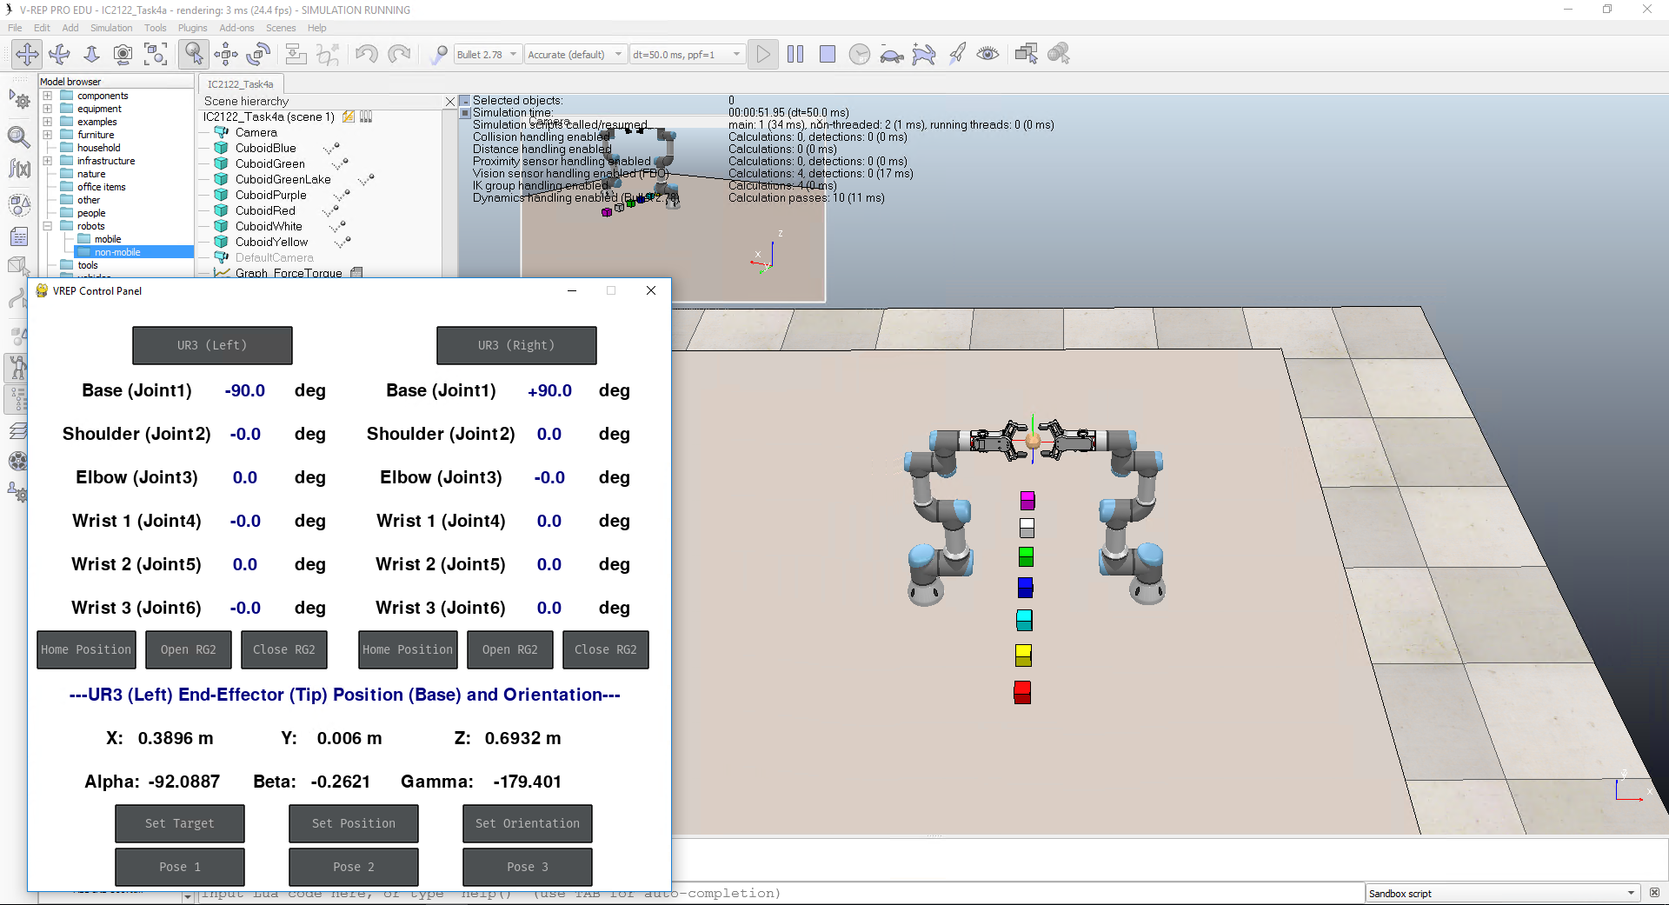
Start-up
V-REP interface :
Rotated & Translated
(UR3B)
Original
(UR3A)

Slide 17
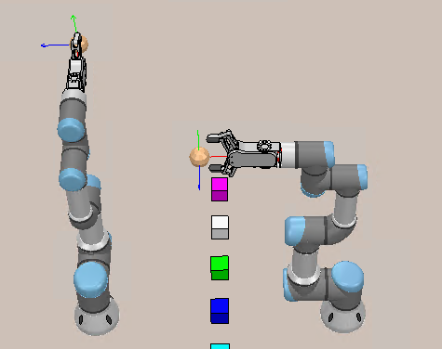
IC2122 – Example
Example: Calculate the translated & rotated value and translation & rotation axis using Homogeneous Transformation
Example: Translated 0.7 m along x-axis and rotated 90 degrees along x-axis
Example Pose
Z
Z
Y
X
X
Y
Original
(UR3A)
Rotated & Translated
(UR3B)

Slide 18
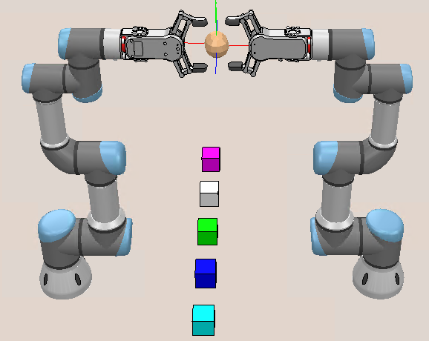
IC2122 – Task 4a
Task 4a: Calculate the translated & rotated value and translation & rotation axis, and Homogeneous Transformation matrix using Homogeneous Transformation
“Pose 1” Result
Z
Y
X
Original
Rotated & Translated

Slide 19
IC2122 – Task 4a (Hints)
Translation:
(You can measure the translated distance at the beginning)
Along x-axis?
Along y-axis?
Along z-axis?

Slide 20
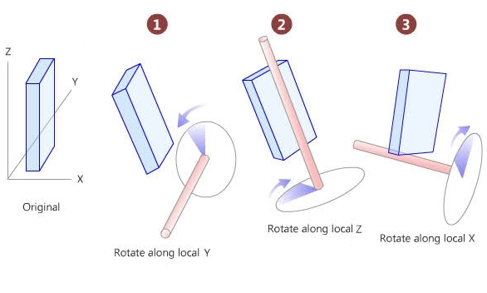
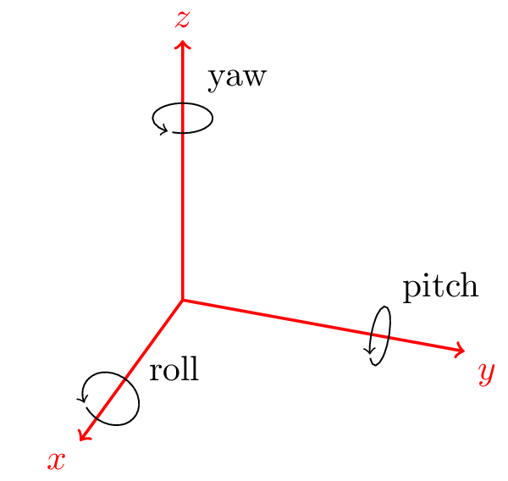
IC2122 – Task 4a (Hints)
Consider the rotation and translation one by one
Rotation:
Along x-axis (Roll)?
Along y-axis (Pitch)?
Along z-axis (Yaw)?

Slide 21
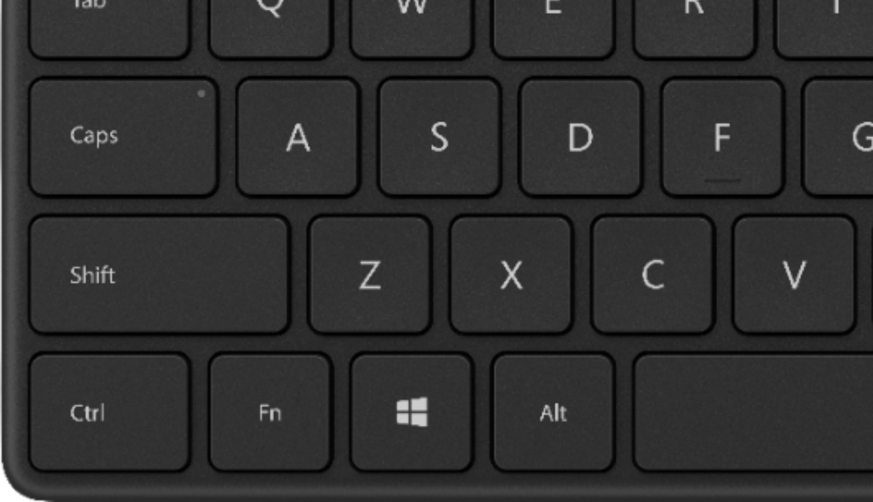
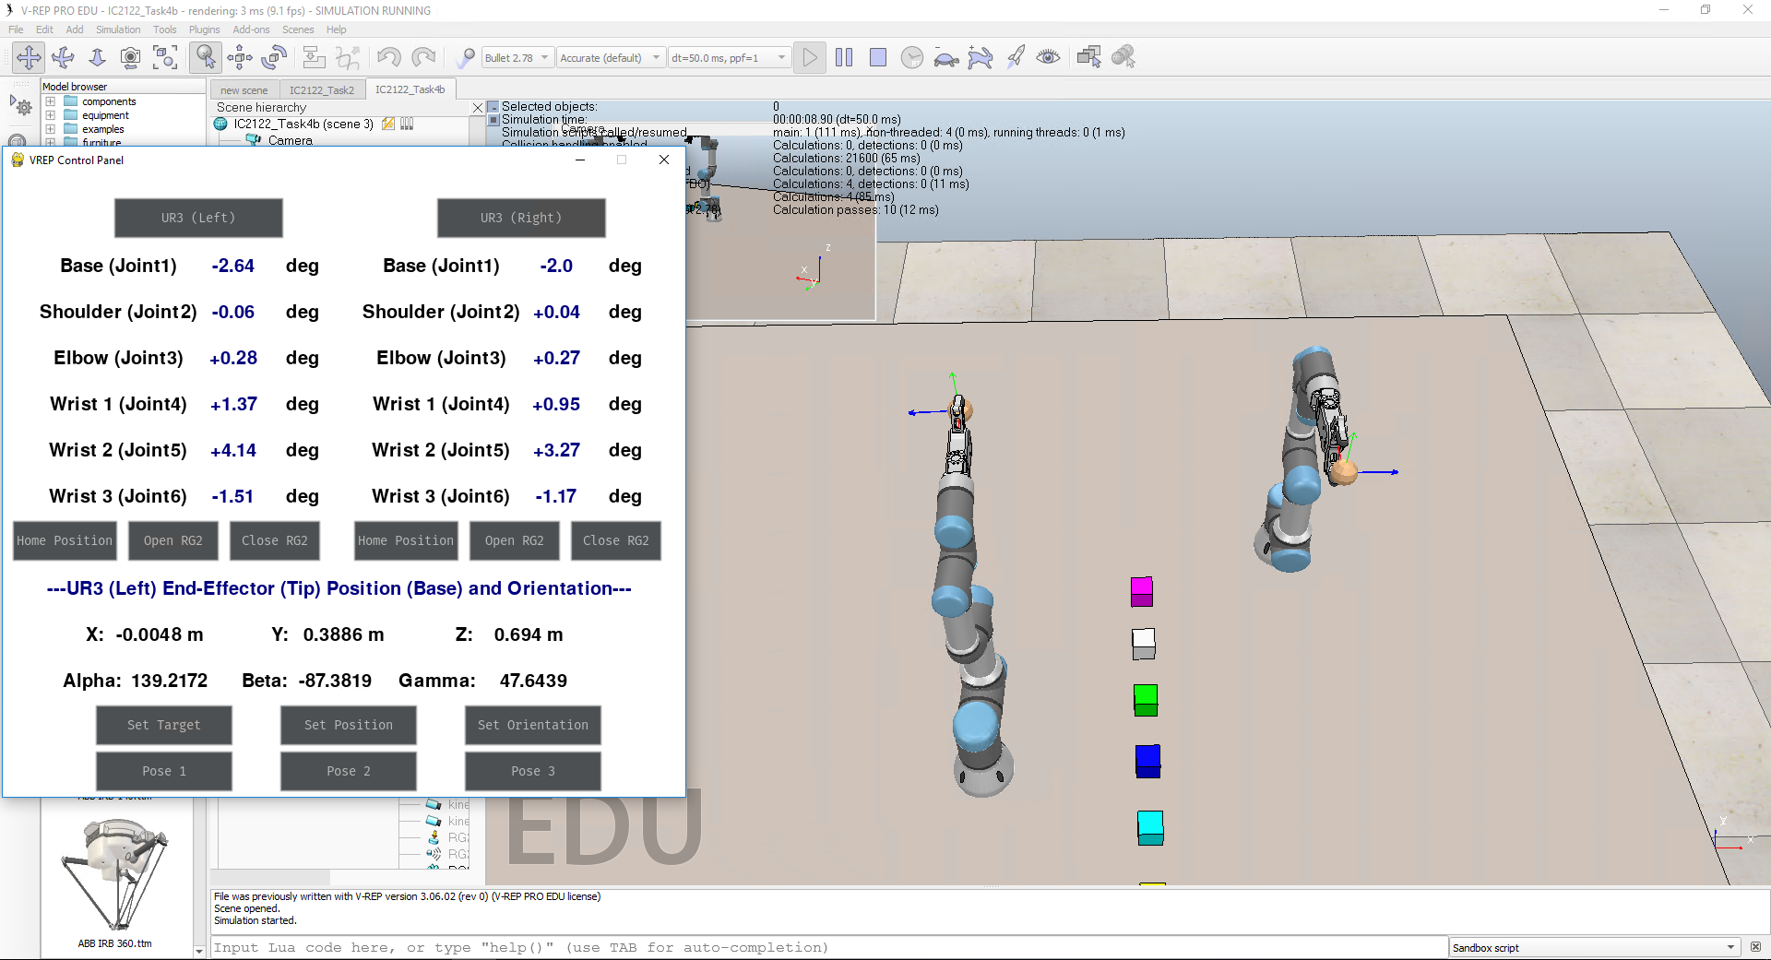
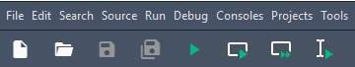
IC2122 – Task 4b
Stop the program by holding “Ctrl” and clicking “C” (IPython console)
Open a new console by holding “Ctrl” and clicking “D” (IPython console)
Close the previous V-REP
Start a new V-REP (Task4b_vrep.bat)
(refer to slide 10)
Switch to Spyder and Run the program
Task 4b interface

Slide 22
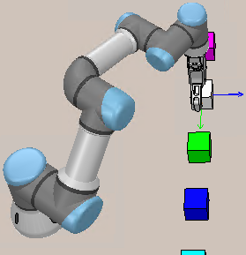
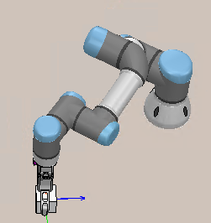
IC2122 – Task 4b
Task 4b: Assume there are two collaborative robots processing with the WHITE block.
Click “Pose 2” button to observe these UR3 action and pose.
Calculate the following results using Homogeneous Transformation
Translated & rotated value and translation & rotation axis
Homogeneous Transformation matrix
WHITE Block position (x, y, z) based on translated and
rotated UR3 (UR3B) coordinate
(Remark: White Block is the target in this Task)
“Pose 2” result
UR3A
UR3B

Slide 23
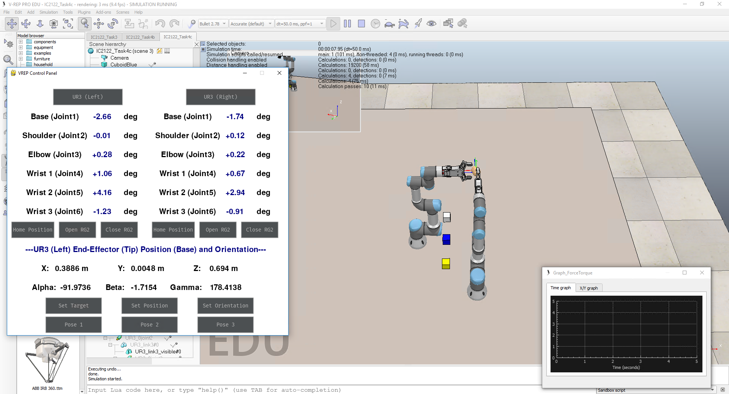
IC2122 – Task 4c
Stop the program by holding “Ctrl” and clicking “C” (IPython console)
Open a new console by holding “Ctrl” and clicking “D” (IPython console)
Close the previous V-REP
Start a new V-REP (Task4c_vrep.bat)
(refer to slide 10)
Switch to Spyder and Run the program
Task 4c interface

Slide 24
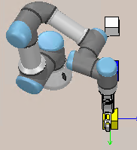
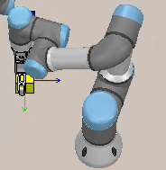
IC2122 – Task 4c
Task 4c: Assume there are two collaborative robots processing with the YELLOW block.
Click “Pose 3” button to observe these UR3 action and pose.
Calculate the following results using Homogeneous Transformation
Translated & rotated value and translation & rotation axis
Homogeneous Transformation matrix
YELLOW Block position (x, y, z) based on translated and
rotated UR3 (UR3B) coordinate
(Remark: YELLOW Block is the target in this Task)
“Pose 3” result
UR3A
UR3B

Slide 25
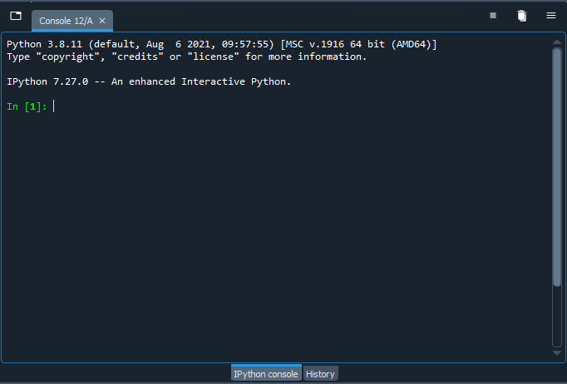
Task4 – Troubleshoot
Step 1: Switch to the Spyder IPython Console
Step 2: Stop the program by holding “Ctrl” and clicking “C”
Step 3: Open a new console by holding “Ctrl” and clicking “D”
Step 4: Stop the V-REP simulation
Step 5: Run the program at Spyder
Step 1
Step 3
Step 2
Step 4
Step 5

Slide 26
Q&A

